Slide 1

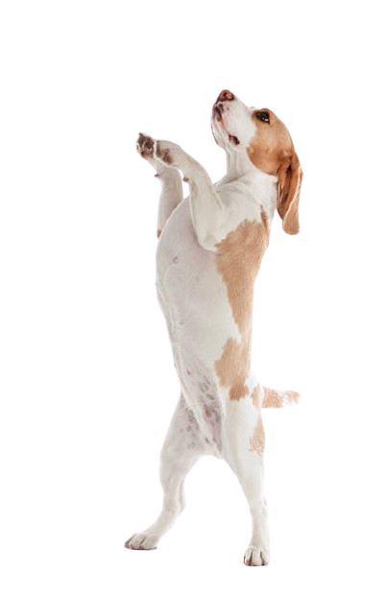
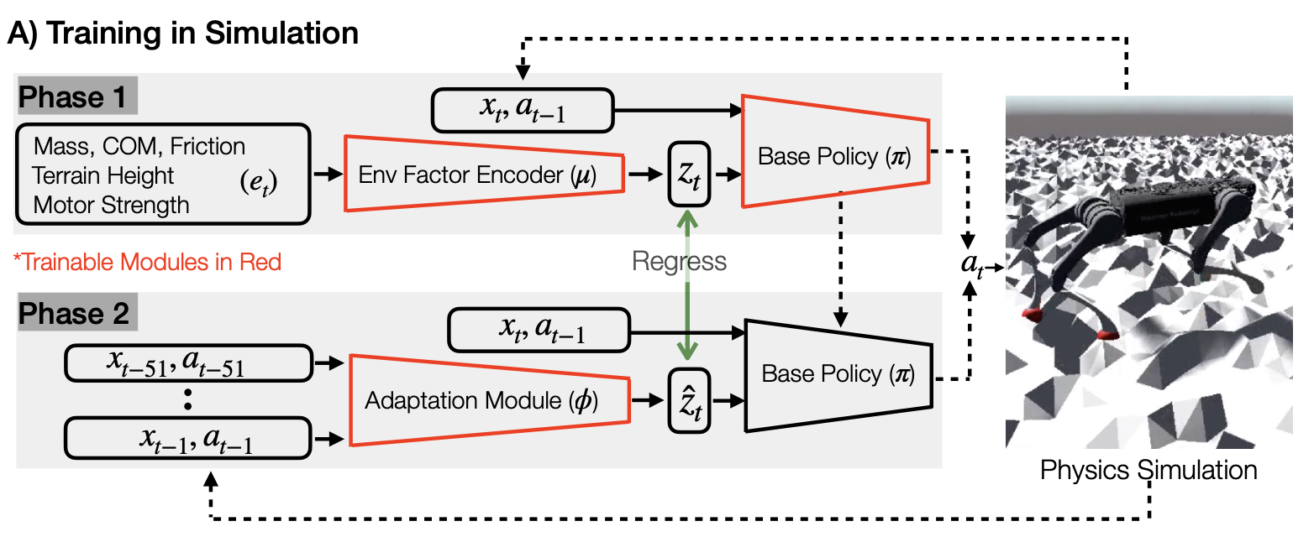
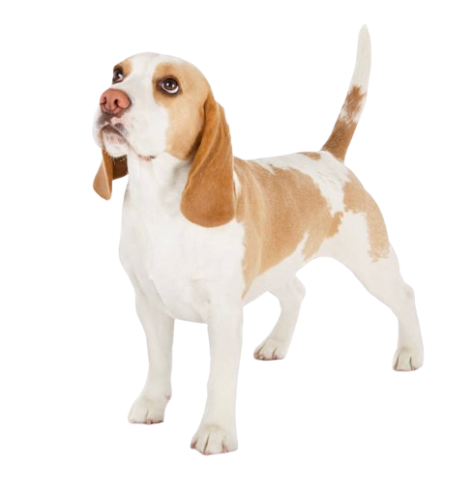
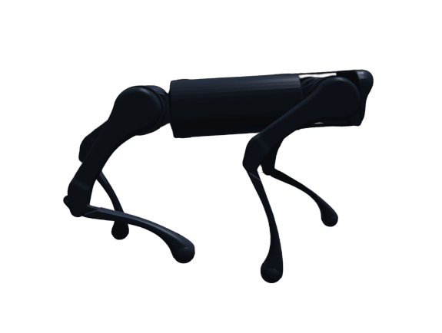
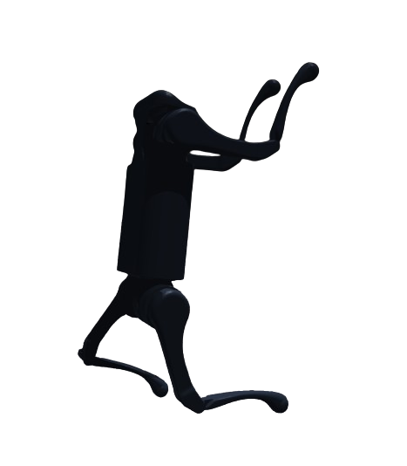
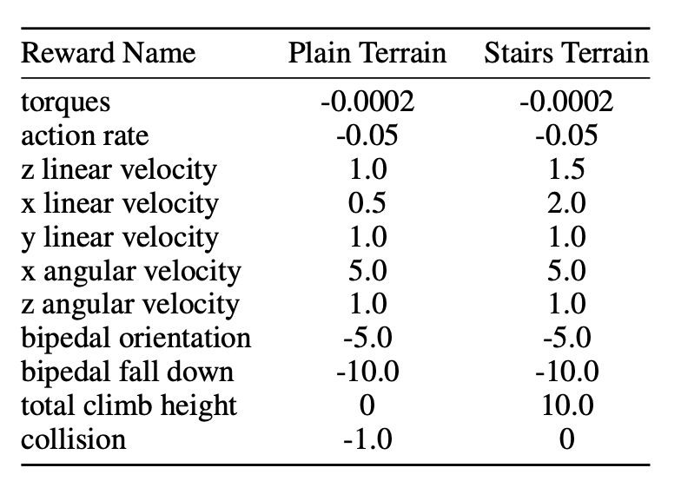
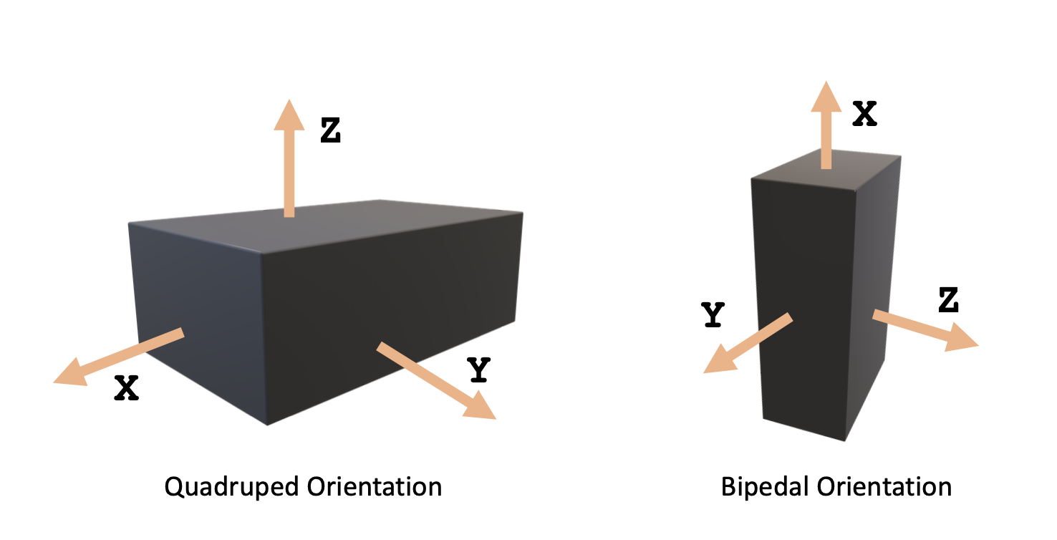
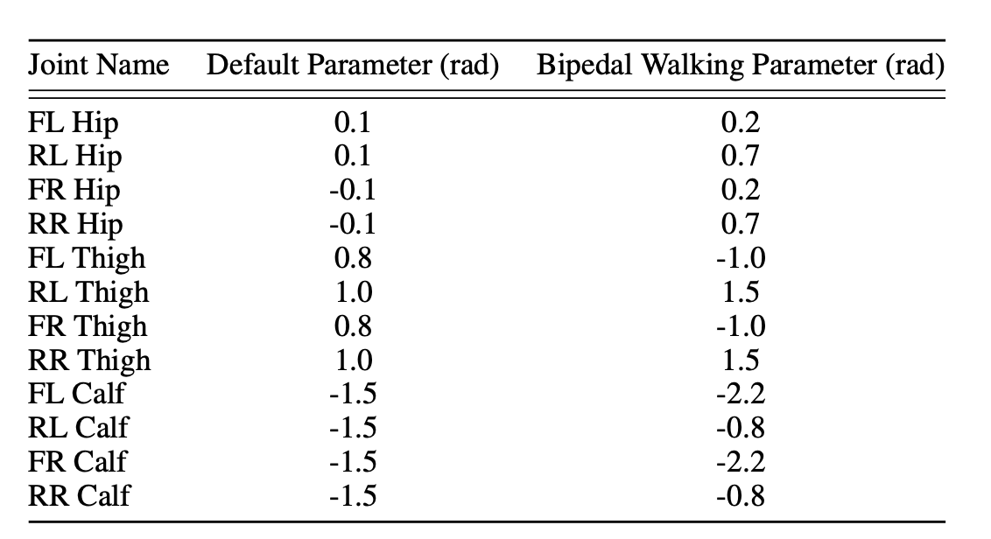
Quadruped Robots Walk Bipedally
Using Reward-Based Methods
Liangsheng Yin (liangsheng.yin@outlook.com) Shanghai Jiao Tong University
Background
Based Framework
Quadruped Robots Walk Bipedally
Train a Dog
Train a Robot
Reward Scales
Bipedal Walking Postures
Challenges
Climb Out of A Pit Bipedally
Keep Balance when walking bipedally
Reward moving forward
Penalize linear deviation
Penalize angular deviation
Penalize falling down
Reward total climb height
Results
The teacher and student models perform similarly on flat surfaces, achieving speeds of up to 3m/s with a fall risk below 2%.
When climbing stairs, the teacher model stands out, reliably reaching the 4th level in a 10-level staircase with steps measuring 0.15m, surpassing the student model, which maxes out at the 3rd level.
Moreover, the teacher model demonstrates superior balance, featuring a lower probability of falling compared to the student model's 10% risk.
Adjust Joints’ Parameters
Reinforcement Learning Course Project
https://lsyin.me

